Slide 1
TDT99 - workshop 1
Christian Lehre

Slide 2
Agenda
Introduction
Methods
Experimental Results
Conclusions

Slide 3
Introduction - Paper
Deep and Confident Prediction for Time Series at Uber,
Lingxue Zhu, Nikolay Laptev

Slide 4
Introduction - Paper
Authors propose an end-to-end Bayesian model to quantify the predictive unceratinty of a time series forecasting model
Authors then apply the proposed model to measure uncertainty during special events and to improve anomaly detection accuracy

Slide 5
Introduction - Motivation
Plain, vanilla neural networks output point estimates
No measure of uncertainty
Overconfident predictions
Important to assess how trustworthy a model is
Predictive uncertainty

Slide 6
Introduction – related work
Classical time series models
GARCH, ARFIMA, etc.
Uncertainty estimation widely studied
Hard to tune, require retraining
Previously proposed LSTM models for time series forecasting
Time Series Extreme Event Foecasting with Neural Networks at Uber, N. Laptev et. al.
Exogenous variables
No measure of uncertainty
Large false anomaly rates during special events

Slide 7
Introduction - Uncertainty
A lot of uncertainty related to model fitting
Distinguish between two sources of uncertainty in modelling
Aleatoric:
Inherent noise of data generating process
Epistemic:
Lack of knowledge
Model uncertainty
Model misspecification

Slide 8
Introduction- Bayesian Statistics
Provides a mathematically grounded framework to reason about model uncertainty
Whereas Frequentist neural networks ouput predictions as point estimates, Bayesian neural networks output distributions
Drawbacks
Computationally expensive, hard to scale
Approximation techniques, e.g
Variational Inference
Monte Carlo Dropout

Slide 9
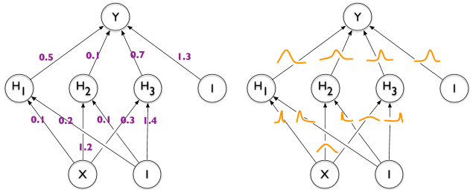
Introduction- Bayesian NNs
https://sanjaykthakur.com/2018/12/05/the-very-basics-of-bayesian-neural-networks/

Slide 10
Methods - Overview
Estimate model uncertainty using Monte Carlo Dropout
Incorporate uncertainty due to model misspecification by an encoder-decoder block applied in a pre-training phase
Use the output of the encoder as input to the prediction network
Estimate aleatoric uncertainty on a held-out validation set

Slide 11
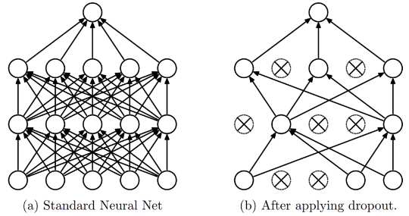
Methods – Monte Carlo Dropout
https://mc.ai/understanding-dropout-2/

Slide 12
Methods – MC Dropout
Keep dropout activated at evaluation, and do B stochastic forward passes of the network
Typically B ~ 100
Distribution of predictions for each instance
Model uncertainty as sample variance
Mathematically equivalent to an approximation of the Gaussian Process, which provides uncertainty estimates
Advantages over other approximation techniques
Applicable to any network architecture
Easy to implement: No need to adjust training algorithm

Slide 13
Methods – Encoder block
Train an Encoder-Decoder network to learn a latent embedding of the time series
Output of encoder as input to prediction net
Idea:
Capture unusual input and model misspecification in the latent space

Slide 14
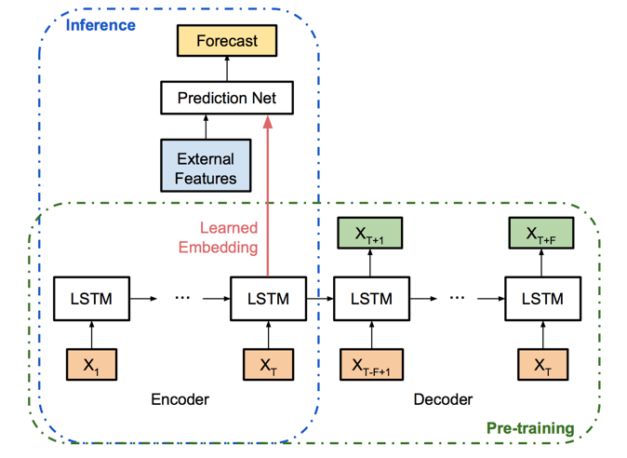
Methods – Full model
Key components:
Encoder net (Pre-training)
LSTM cells
Prediction net
Fully connected
https://eng.uber.com/neural-networks-uncertainty-estimation/

Slide 15
Methods – Quantifying Uncertainty
MC dropout is applied to both the encoder and the prediction net
Model uncertainty (Prediction net)
Model misspecification (Encoder)
Estimate Aleaoric uncertainty using RSS on a held-out validation set
Combine epistemic and aleatoric uncertainty, and calculate 95% prediction intervals
Evaluate uncertainty measure by an empirical coverage of the prediction interval

Slide 16
Experimental setting
4 years worth of daily uber trips in 8 major cities in US and Canada
3 years for training
8 months for testing
4 months for validation set (aleatoric uncertainty)
Sampling
Each time series consists of 28 consequtive days, where the last day is forecasted

Slide 17
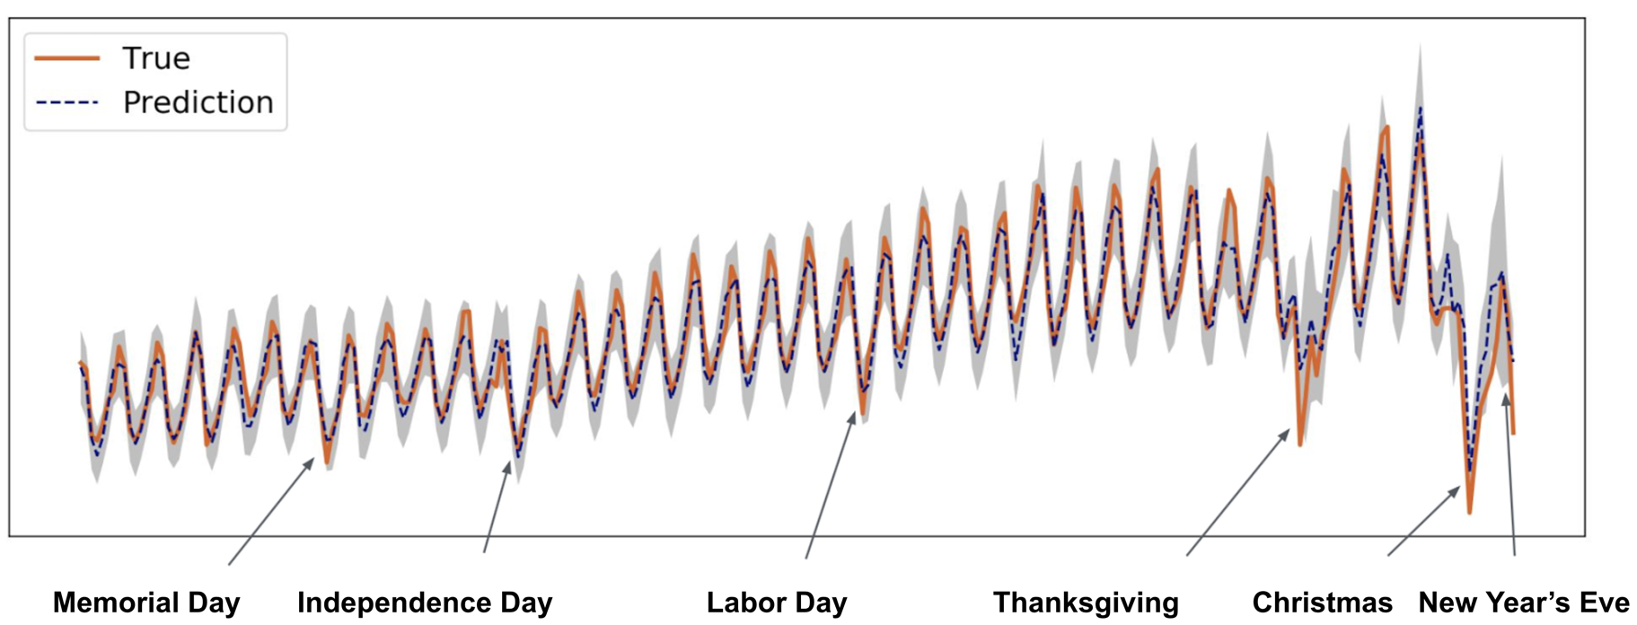
Experimental Results – Daily Uber Trips in SF on test set
https://eng.uber.com/neural-networks-uncertainty-estimation/

Slide 18
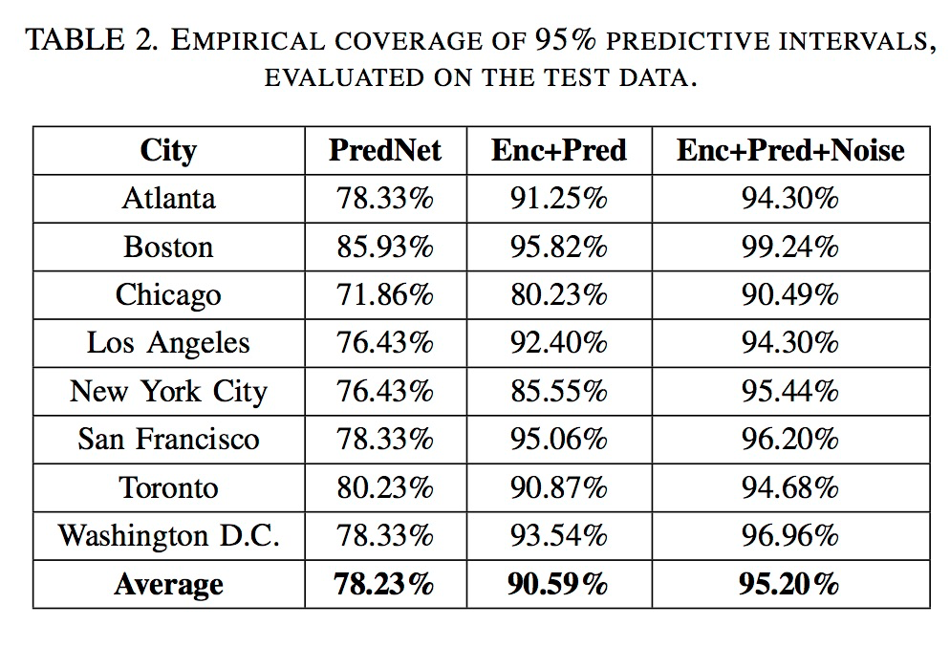
Experimental Results – Daily Uber Trips in SF on test set
https://eng.uber.com/neural-networks-uncertainty-estimation/

Slide 19
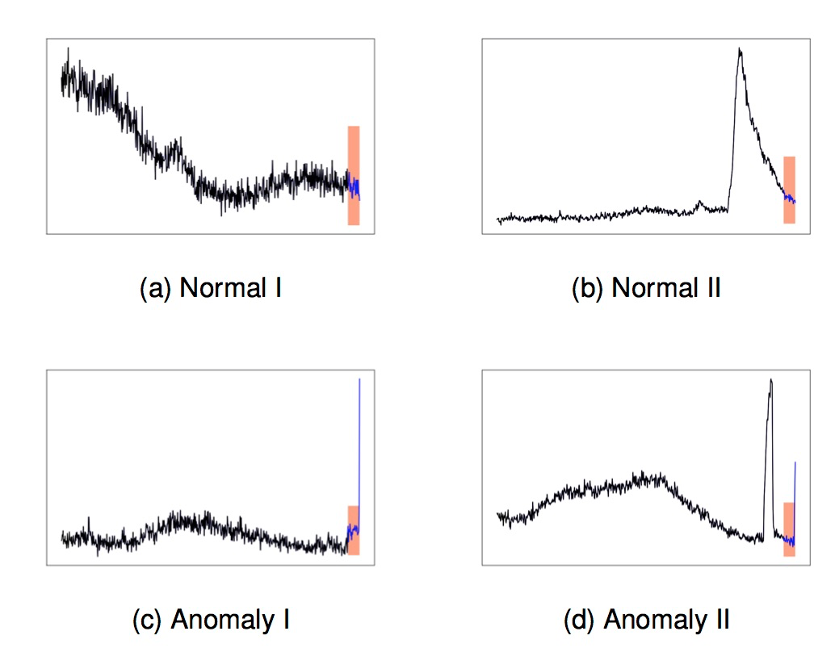
Experimental Results – Anomaly Detection on different metrics
https://eng.uber.com/neural-networks-uncertainty-estimation/

Slide 20
Conclusions
Authors presents a simple way to provide uncertainty estimates for a neural network using MC dropout
Succsessfully incorporate the previously unexplored uncertainty due to model misspecification using an encoder network
Proposed unceratinty estimates was shown to improve the the anomaly detection accuracy at Uber
4% improvent in precision, over millions of status-montoring metrics
Error estimates based on the proposed model runs in production at uber
Future work:
Utilize the uncertainty estimates for debugging neural networks during periods of high error

Slide 21
Thank you for your attention!
Christian Lehre

